Slide 1


Artificial Intelligence
Chapter 17. Knowledge-Based Systems {第17章 基于知识的系统}

Slide 2
Structure of KB System
User
Expert/s
Knowledge Engineer
Human-Computer Interface
Knowledge
Acquisition
Subsystem
Explanation
Subsystem
Knowledge
Base
Inference
Engine

Slide 3
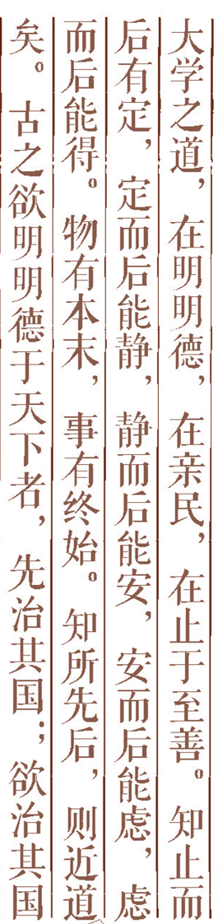




Confronting the Real World [面对现实世界]
Reasoning Using Horn Clauses [用Horn子句进行推理]
Maintenance in Dynamic Knowledge Bases[动态知识库的维持]
Rule-Based Expert Systems [基于规则的专家系统]
Rule Learning [规则学习]
Additional Readings and Discussion [补充读物和讨论]
Outline

Slide 4
17.1 Confronting the Real World
Knowledge-based systems
Programs that reason over extensive knowledge bases.
Do the methods scale up sufficiently well for practical applications?
Three major theoretical properties of logical reasoning systems.
Soundness
To be confident that an inferred conclusion is true
Completeness
To be confident that inference will eventually produce any true conclusion
Tractability
To be confident that inference is feasible

Slide 5
17.1 Confronting the Real World
Predicate calculus
Resolution refutation is sound and complete, but semi-decidable.
Semi-decidablility makes the predicate calculus inherently intractable.
Even on problems for which resolution refutation terminates, the procedure is (NP-hard ?).
This fact has led many to despair of using formal, logical methods for large-scale reasoning problems.

Slide 6
NP-hard?
Definition: The complexity class of decision problems that are intrinsically harder than those that can be solved by a nondeterministic Turing machine in polynomial time. When a decision version of a combinatorial optimization problem is proved to belong to the class of NP-complete problems, which includes well-known problems such as satisfiability, traveling salesman, the bin packing problem, etc., then the optimization version is NP-hard.

Slide 7
Complexity class
Definition: Any of a set of computational problems with the same bounds ( Θ(n)) on time and space, for deterministic and nondeterministic machines.
decision problem
Definition: A problem with a "yes" or "no" answer. Equivalently, a function whose range is two values, such as {0,1}.

Slide 8
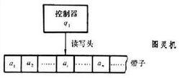
Nondeterministic Turing machine
Definition: A Turing machine which has more than one next state for some combinations of contents of the current cell and current state. An input is accepted if any move sequence leads to acceptance.

Slide 9
17.1 Confronting the Real World
To make reasoning more efficient
We could use procedures that might occasionally prove an untrue formula.
We could use procedures that might not be guaranteed to find proofs of true formulas.
We could use a language that is less expressive than the full predicate calculus.
Reasoning is typically more efficient with Horn clauses.

Slide 10
17.2 Reasoning Using Horn Clauses
Horn Clauses
Clauses that have at most one positive literal.
Rule:
There is at least one negative literal and a single positive literal.
The literal λ_{h} is called the head of the clause.
The ordered list of literals, λ_{b1} ,…, λ_{bn}, is called body.
Fact:
There may be no negative literals in the clause.
Goal:
There may be no positive literal in the clause.
Horn clauses form the basis of the programming language PROLOG.

Slide 11
Inference over PROLOG Clauses (1/2)
Resolution Operation
A goal can resolve with a fact by unifying the fact with one of the literals in the goal.
The resolvent is a new goal consisting of a list of all of the substitution instances of the other literals in the original goal.
A goal can resolve with a rule by unifying the head of the rule with one of the literals in the goal.
The resolvent is a new goal formed by appending the list of substitution instances of all of the literals in the body of the rule to the front of the list of substitution instances of all of the other (nonresolved-upon) literals in the goal.

Slide 12
Inference over PROLOG Clauses (2/2)
PROLOG programs
The clauses are usually ordered in the following way: goal, facts, rules.
Proof of a goal clause succeeds when the new goal produced by a resolution is empty.
Depth-first, backtracking search procedure
A goal clause fails if the interpreter has tried all resolutions for one of the goal literals and none results in new goals that can be proved.
The interpreter backtracks to the previous goal clause and tries other resolutions on it.

Slide 13
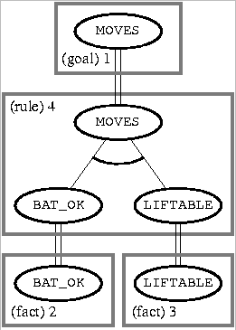
Example of an AND/OR Tree (1)
Body nodes are called AND nodes because they must all be proved.
If there had been alternative resolutions possible, the search for a proof tree could have generated additional nodes, called OR nodes.
:- MOVES
BAT_OK :-
LIFTABLE :-
MOVES :- BAT_OK, LIFTABLE

Slide 14
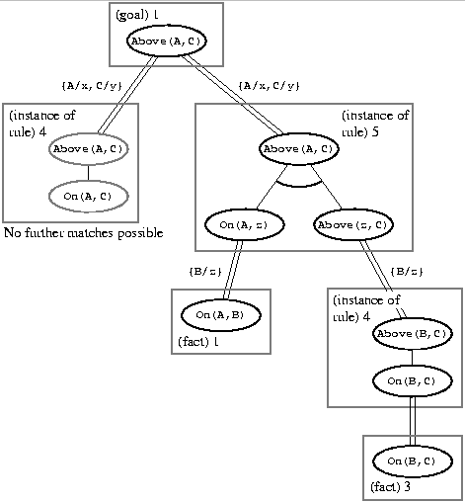
Example of an AND/OR Tree (2)
Consistency requires that the same term be substituted for the variable throughout the proof tree.
:- Above(A,C)
On(A,B) :-
On(B,C) :-
Above(x,y) :- On(x,y)
Above(x,y) :- On(x,z), Above(z,y)

Slide 15
Forward Chaining
Forward chaining system
Reasoning proceeds forward, beginning with facts, chaining through rules, and finally establishing the goal.
A rule is applicable if each of the literals in its antecedent can be unified with a corresponding fact.
When more than one rule is applicable, some sort of external conflict resolution scheme is used to decide which rule will be applied.
Model of aspects of human cognitive processing
Facts: working of short-term memory
Rules: long-term memory

Slide 16
17.3 Maintenance in Dynamic Knowledge Bases
Knowledge base of propositional calculus atoms
The atoms are called premisses instead of facts.
The rules are not restricted to being Horn rules.
A spreadline reasoning system
Any cell that has a formula in it gets its vale immediately calculated from the values of components.
If the values of any components of a formula happen to change, the value of that formula is automatically changed.

Slide 17
17.3 Maintenance in Dynamic Knowledge Bases
Truth maintenance systems (TMSs)
Dynamic knowledge base: the spreadline is extended to contain any number of premisses and rules.
The formulas entered in the values of rule cells are called justifications.
The values of certain premiss cells can be omitted.
When a cell has a value of 1 or 0, it is called IN; otherwise, out.
Allowing values of cells to be OUT permits an interesting generalization of rule types (e.g, U if R is True and S is Out).

Slide 18
17.3 Maintenance in Dynamic Knowledge Bases
TMSs should be thought of as knowledge base maintenance systems that perform automatic updates when the truth values of certain atoms are changed.
The use of IN’s and OUT’s permits an elementary sort of “monotonic” or defeasible inference not sanctioned by ordinary reasoning systems.
Cycles among the rules present some difficulties.
One is mutual justification.

Slide 19
17.3 Maintenance in Dynamic Knowledge Bases
Assumption-based truth maintenance systems (ATMSs)
The spreadline is used in a backward direction.
We start with a particular cell’s formula and ask which premiss values will make the formula in that cell True.
Other formulas called the background theory are considered together.
Labels of the cells
The values of the cells are taken to be formulas-expressed in DNF form in terms of the premiss atoms.
ATMSs can be used for a variety of purposes.
One is to perform diagnosis.

Slide 20
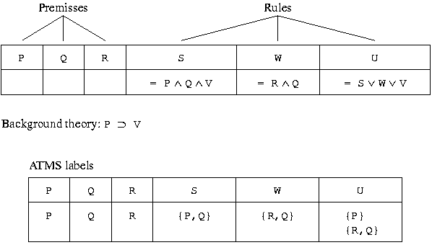
17.3 Maintenance in Dynamic Knowledge Bases
Conversion of a TMS to an ATMS

Slide 21
Exercise
How to handle inconsistent knowledge.
For example,
Source 1: John is 180cm tall.
Source 2: John is 178cm tall.

